Slide 1

Situational Irony: Reality is different from what is expected.
Let’s review with a few gifs from...

Slide 2
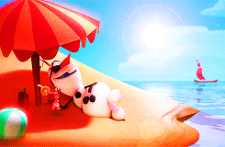
Situational Irony: Reality is different from what is expected.
Olaf in summer is ironic because…
Notes:
----- Meeting Notes (2/6/17 11:53) -----
We expect snowmen to hate the summer; in reality, Olaf loves summer.

Slide 3
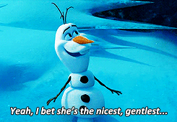
Situational Irony: Reality is different from what is expected.
Olaf being impaled is ironic because…
Notes:
----- Meeting Notes (2/6/17 11:53) -----
We expect the nicest, gentlest person to be surrounded by nice things; in reality she is surrounded by sharp, impaling ice cycles.

Slide 4
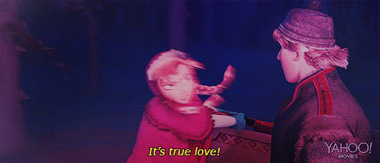
Situational Irony: Reality is different from what is expected.
Anna talking about true love is ironic because…
Notes:
----- Meeting Notes (2/6/17 11:53) -----
We expect someone talking about true love to be all warm and fuzzy, but in reality she is angrily hitting an attacking wolf.

Slide 5
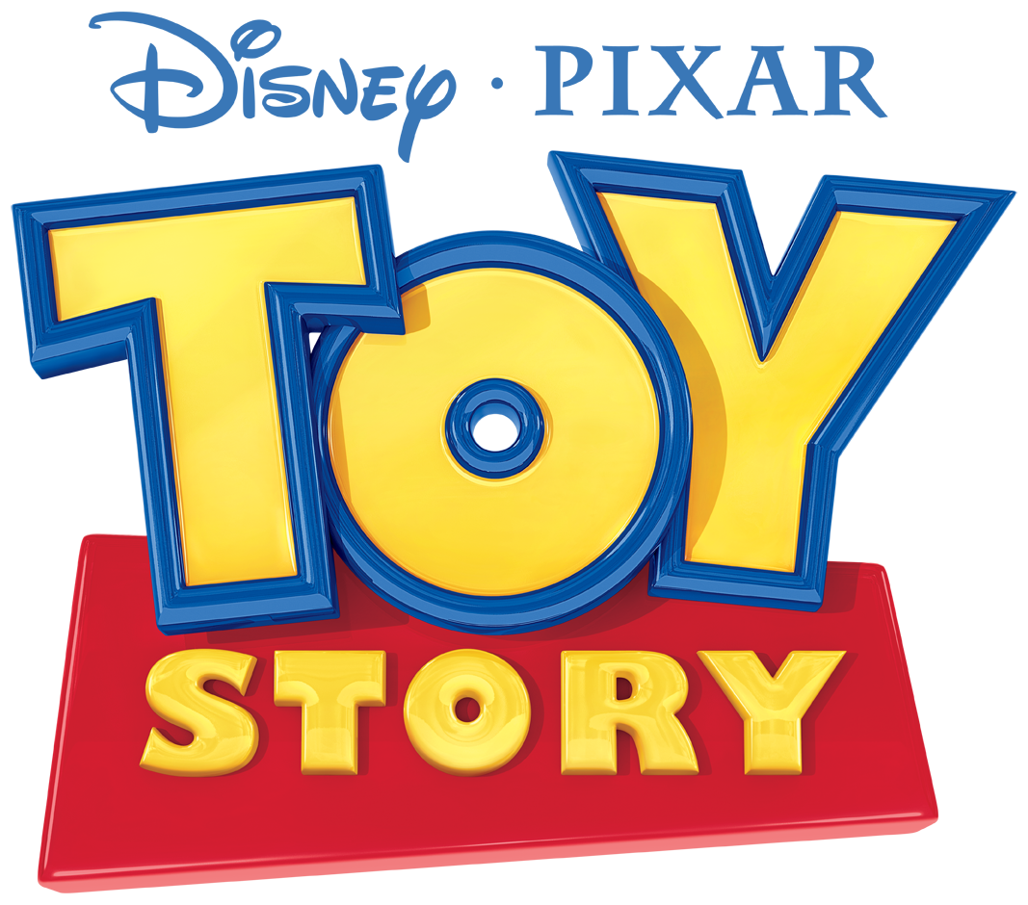
Dramatic Irony: We know something the characters do not know.
Let’s review with a few gifs from...

Slide 6
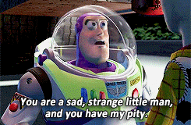
Dramatic Irony: We know something the characters do not know.
Buzz’s response to “you are a toy” is ironic because…
Notes:
----- Meeting Notes (2/6/17 11:53) -----
We know they are toys; Buzz does not know he is a toy.

Slide 7
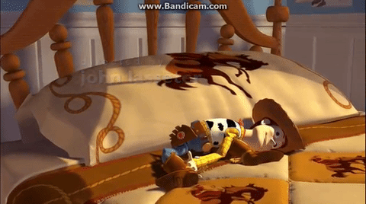
Dramatic Irony: We know something the characters do not know.
Woody sitting up at the beginning of the movie is ironic because…
Notes:
----- Meeting Notes (2/6/17 11:53) -----
We know the toys are alive; the humans do not know they are alive.

Slide 8
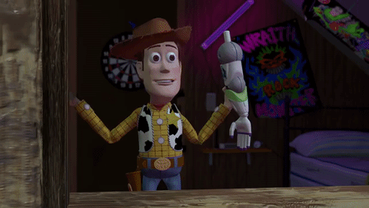
Dramatic Irony: We know something the characters do not know.
Rex’s response to Woody’s arm is ironic because…
Notes:
----- Meeting Notes (2/6/17 11:53) -----
The toys think Woody killed Buzz, but we know Buzz is okay.

Slide 9

Verbal Irony: What is said is different from what is meant
Let’s review with a few gifs from...

Slide 10
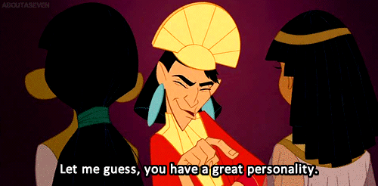
Verbal Irony: What is said is different from what is meant
Kuzco’s comments as he judges potential wives is ironic because…
Notes:
----- Meeting Notes (2/6/17 11:53) -----
He doesn't really think she has a great personality.

Slide 11
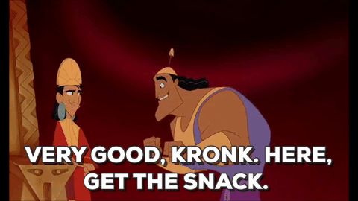
Verbal Irony: What is said is different from what is meant
Kuzco’s comments after Kronk answers a simple question is ironic because…
Notes:
----- Meeting Notes (2/6/17 11:53) -----
He is not actually impressed with his answer.

Slide 12
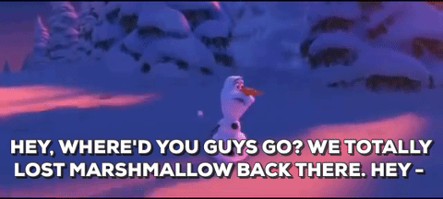
Verbal Irony: What is said is different from what is meant
Olaf calling it “Marshmallow” is ironic because…
Notes:
----- Meeting Notes (2/6/17 11:53) -----
The monster is nothing like a soft, squishy, delicious marshmallow.

Slide 13
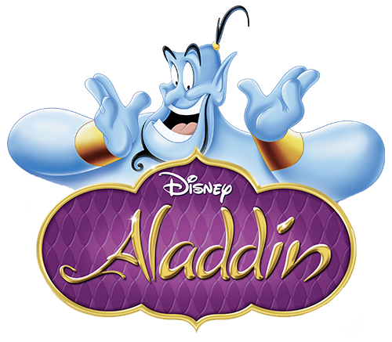
The three types of irony to develop theme
Let’s review everything and put it all together with a clip from…

Slide 14
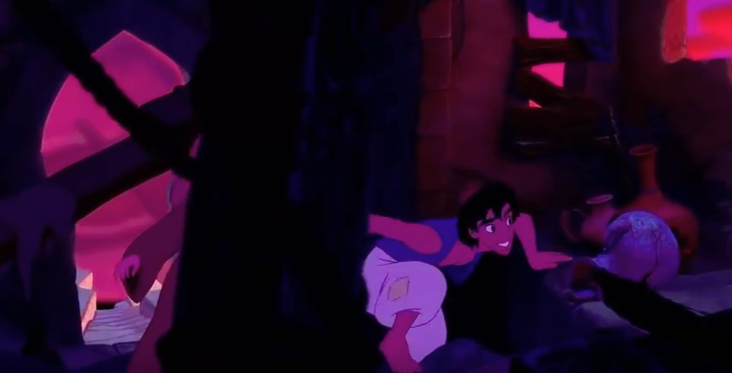
The three types of irony to develop theme
Notes:
----- Meeting Notes (2/6/17 11:53) -----
Situational: Jasmine thinks she would be happy if only she was poor, and Aladdin thinks he would be happy if only he was rich.
Dramatic: We know Jasmine is a princess, but Aladdin doesn't know.
Verbal: She does not actually think living in the palace is wonderful.

